Slide 1


Adoption Ladder Workshop 2
Monday 29th March
Core RA team

Slide 2
Summary of decisions and open items
Ladder labelled as step #1 to #5
Single ladder but incorporating segment-specific messages and sources when appropriate
Need to clarify certain terms and differentiate digital from Omnichannel

Slide 3



Behaviour Change
CURRENT
Uses a very broad spectrum of products including JAKs
Uses very recently launched products
Able to talk extensively about new and pipeline treatments
Willing to act ahead of guidelines
DESIRED
Tries JYSELECA with some patients
(After they have gained experience) Expand JYSELECA use in a wider range of patients in preference to other JAKs
Unmet Need
Research
1st Rx
Prescribes
Advocates
Adoption Stage
#1
#2
#3
#4
#5
Mavericks: insert here
Pragmatists: insert here
Compassionates: Insert here
Galapagos Goal
Highly competitive environment with comparisons between treatments hard to make.
Treatment inertia and need to overcome mindset shift
Barriers
Mvrks
Messages
Prgmts
Cmpsts
Message Source
KOL Video
Study x
Guidelines

Slide 4
Workshop Context
Workshop Objectives
Last week, we agreed on an Adoption Ladder template providing a balanced view between the simplicity of a one-page view and between the specificities of HCP segments
We are therefore now focusing on filling this template leveraging the great existing work and knowledge together, to form the foundations for the rapid development.
Finalise the co-creation of the Adoption Ladder for RA
From 12pm to 1pm (CET):
Goals & Barriers
From 2pm to 3pm (CET):
Messages & Message sources
We thank in advance the inputs provided by Elisabeth and the DDB team

Slide 5
Let’s have an efficient session!
Time Keeper
‘Rabbit hole’ Monitor
Keeps us on-time and reminds the group when we need to move forward
If we go ‘off-topic’ from the meeting objectives, the monitor will raise speak up, note the topic for a follow-up, and bring us back to topic.
Alex Richwood
Louisa Peacock

Slide 6


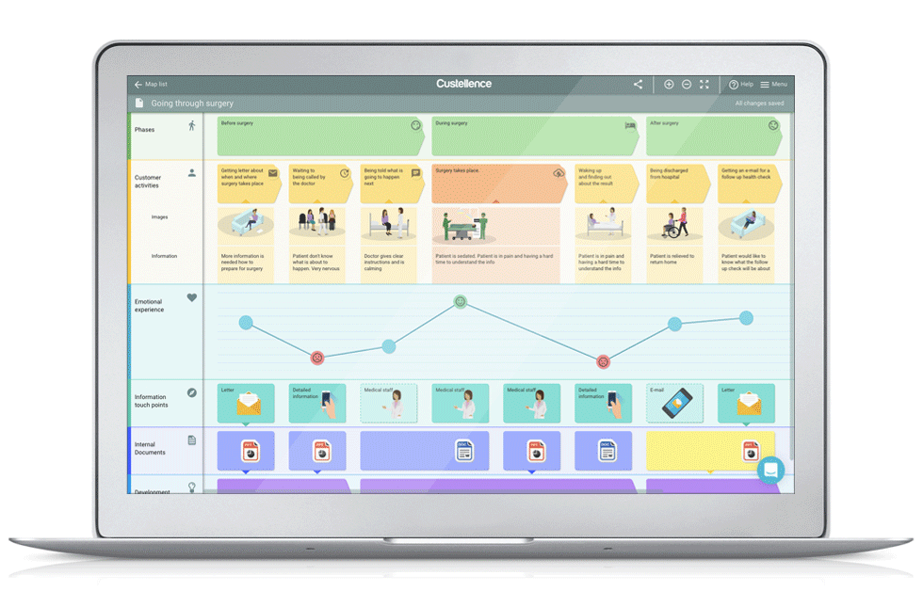
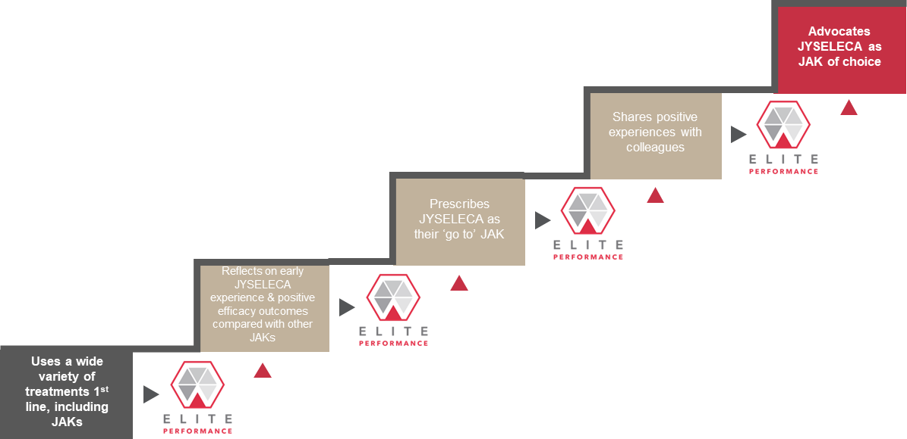



Adoption Ladder
HCP Journey
Execution plan
The HCP-focused mapping of the level of product adoption.
The articulation of the
touchpoints with a HCP.
The implementation by the
country teams with HCPs
Journey discovery
01
02
Journey Insights
Journey Mapping
HCP Journey Capabilities
05
t
03
Journey Orchestration
Journey Optimization
04

Slide 7
Comprehensive View – Summary of Workshop Discussions

Slide 8
Behaviour Change
CURRENT
Uses a very broad spectrum of products including JAKs
Uses very recently launched products
Able to talk extensively about new and pipeline treatments
Willing to act ahead of guidelines
DESIRED
Tries JYSELECA with some patients
(After they have gained experience) Expand JYSELECA use in a wider range of patients in preference to other JAKs
Unmet Need
Research
1st Rx
Prescribes
Advocates
Adoption Stage
#1
#2
#3
#4
#5
High-Level Goal
To demonstrate that despite new treatments, unmet needs still remain, especially related to a balance of efficacy and safety
Segmented Goals
Mavericks: Uses a wide variety of treatments 1st line, including JAKs
Pragmatists: Occasionally uses JAKs but not consistently [high variation within segment – some are very high JAK users]
Compassionates: Uses a variety of products based on patient need & guideline recommendations
High-Level Goal
To ensure early positive experiences as proof of concept (and to share with peers)
Segmented Goals
Mavericks: Reflects on early JYSELECA experience & positive efficacy outcomes compared with other JAKs
Pragmatists: Attends a peer-to peer discussion with local colleagues about their experiences with JYSELECA & its safety profile
Compassionates: Attends a discussion with local expert about their experiences with JYSELECA & its safety profile
High-Level Goal
To differentiate JYSELECA versus other JAKs, especially RINVOQ
Segmented Goals
Mavericks: Prescribes JYSELECA as their ‘go to’ JAK
Pragmatists: Prescribes JYSELECA for some patients where safety is the main concern
Compassionates: Prescribes JYSELECA for some patients where safety & simplicity are important
High-Level Goal
To create an environment that facilitates exchange of positive experiences
Segmented Goals
Mavericks: Shares positive experiences with colleagues
Pragmatists: Gains depth of experience in patients where safety is a concern
Compassionates: Monitors feedback & safety signals in JYSELECA patients
High-Level Goal
To identify, support, and create a platform for JYSELECA advocates
Segmented Goals
Mavericks: Advocates JYSELECA as JAK of choice
Pragmatists: Expands the use of JYSELECA to different types of patients so ultimately JYSELECA becomes JAK of choice
Compassionates: Starts to use JYSELECA as first line JAK inhibitor
Galapagos Goal
Currently Unsegmented Barriers
Satisfied with current options
Complacency/habit
Don’t believe there are significant unmet needs that can be addressed by (another) JAK
Believe another MOA will be needed to address unmet needs
Communication gap between patients and HCPs that masks unmet needs/treatment gaps (especially Compassionates)
CoVid context : access challenge to care
Highly competitive environment with comparisons between treatments hard to make.
Treatment inertia and need to overcome mindset shift
Currently Unsegmented Barriers
Awareness & Access
Access to JYSELECA
Lack of access to sampling
Lack of experience with JYSELECA
Lack of familiarity with Galapagos and new relationship with reps
Differentiation
Perceived lack of differentiation from RINVOQ
Sees no difference in clinic relative to RINVOQ
Negative Safety Halo
Residual JAK concerns from 1st generation
Clinical
Has a negative experience in a patient in first few patients
Lack of clarity of who the ideal JYSELECA patient is
Currently Unsegmented Barriers
Satisfaction with their current JAK and no reason to change
Prefer to have a wide armamentarium, rather than a go-to
Like to keep options open as new entries emerge
Competitive messaging and share of voice
Uncertainty around available JYSELELCA support services for HCPs and patients
Unsure of which patient population to expand usage in
Currently Unsegmented Barriers
Negative experiences that temper their enthusiasm
Wanting to appear unbiased/unaligned with a brand
Currently Unsegmented Barriers
Do not have a JAK of choice and philosophically opposed to aligning with one product
Don’t have a platform from which to advocate
Barriers
Summary of RA Workshop Discussion (1 of 2)

Slide 9
Behaviour Change
CURRENT
Uses a very broad spectrum of products including JAKs
Uses very recently launched products
Able to talk extensively about new and pipeline treatments
Willing to act ahead of guidelines
DESIRED
Tries JYSELECA with some patients
(After they have gained experience) Expand JYSELECA use in a wider range of patients in preference to other JAKs
Unmet Need
Research
1st Rx
Prescribes
Advocates
Adoption Stage
#1
#2
#3
#4
#5
Message Objective by Segment:
Mavericks: significant need for new treatment options – they already agree with this and are keen to try new options, esp if efficacy is not compromised
Pragmatists: need for more safe treatment options that do not compromise on efficacy
Compassionates: focus on unmet needs from a patient perspective – less from an HCP perspective
Message Topics:
Unmet needs messaging : 1/3 patients are refractory, EULAR guidelines, (5messages in total)
FAQ on CoVid impact
Message Objective by Segment:
Mavericks: expose to full data esp efficacy, give opportunity to try – make it easy, but they will be interested
Pragmatists: expose to full data incl safety, ref trusted peers/colleagues and hands on experience
Compassionates: KOL/Peer/trusted source perspectives on JYS safety and simplicity – ‘permission to try’
Message Topics
Now available
MoA : selectivity (vs 1G)
Comprehensive clinical evidence : 3 CT and long term data
Strength of balance story : full strength with safety)
Reimbursement : (to be localised)
Patient identification
HCP and Patient Support Service (Cpst) / to be localised)
Message Objective by Segment:
Mavericks: reinforce experience, share additional data freely, seed need to share with others
Pragmatists: advocate trial and follow up re experience and expansion of trial use
Compassionates: share/encourage patient feedback, patient perspectives, PIO
Message Topics
Efficacy
Safety
Patient Profiles
Patient identification
Corporate support
HCP and Patient Support Service
Message Objective by Segment:
Mavericks: provide opportunities to share experience and discuss with others
Pragmatists: expand patient types as experience is gained – give different ‘pegs
Compassionates: Monitors feedback & safety signals in JYSELECA patients
Message Topics
Efficacy
Safety
Patient Profiles
Patient identification
Corporate support
HCP and Patient Support Service
Message Objective by Segment:
Mavericks: KOL opportunities – keeping in mind loyalty can prob not be expected
Pragmatists: consolidate experience to lead to JAK of choice ‘peg’]
Compassionates: consolidate experience and ptn feedback to lead to JAK of choice ‘peg’ and 1L use
Message Topics
Corporate support
HCP and Patient Support Service
Partnership opportunities
Messages
Message Source
Detail Aid…
Implementation Guide
LearnJAKStat
Published literature (cost of lack of ttt)
FAQ
TeachJAKStat
MyMentum drop material
Detail Aid…
Finch video
Available publications
(refer to channel preference to maximize interactions by segments)
HCP Portal (pending country site map)
- To be Discussed
- To be Discussed
- To be Discussed
Summary of Workshop Discussion (2 of 2)

Slide 10
Galapagos Goals

Slide 11
Example is for Pragmatists
Behaviour Change
CURRENT
Uses a very broad spectrum of products including JAKs
Uses very recently launched products
Able to talk extensively about new and pipeline treatments
Willing to act ahead of guidelines
DESIRED
Tries JYSELECA with some patients
(After they have gained experience) Expand JYSELECA use in a wider range of patients in preference to other JAKs
Unmet Need
Research
1st Rx
Prescribes
Advocates
Adoption Stage
#1
#2
#3
#4
#5
Mavericks: Uses a wide variety of treatments 1st line, including JAKs
Pragmatists: Occasionally uses JAKs but not consistently [high variation within segment – some are very high JAK users]
Compassionates: Uses a variety of products based on patient need & guideline recommendations
Mavericks: Reflects on early JYSELECA experience & positive efficacy outcomes compared with other JAKs
Pragmatists: Attends a peer-to peer discussion with local colleagues about their experiences with JYSELECA & its safety profile
Compassionates: Attends a discussion with local expert about their experiences with JYSELECA & its safety profile
Compassionates: Insert here
Mavericks: Prescribes JYSELECA as their ‘go to’ JAK
Pragmatists: Prescribes JYSELECA for some patients where safety is the main concern
Compassionates: Prescribes JYSELECA for some patients where safety & simplicity are important
Mavericks: Shares positive experiences with colleagues
Pragmatists: Gains depth of experience in patients where safety is a concern
Compassionates: Monitors feedback & safety signals in JYSELECA patients
Mavericks: Advocates JYSELECA as JAK of choice
Pragmatists: Expands the use of JYSELECA to different types of patients so ultimately JYSELECA becomes JAK of choice
Compassionates: Starts to use JYSELECA as first line JAK inhibitor
Galapagos Goal
Highly competitive environment with comparisons between treatments hard to make.
Treatment inertia and need to overcome mindset shift
Barriers
[significant need for new treatment options – they already agree with this and are keen to try new options, esp if efficacy is not compromised]
[expose to full data esp efficacy, give opportunity to try – make it easy, but they will be interested]
[reinforce experience, share additional data freely, seed need to share with others]
[provide opportunities to share experience and discuss with others]
[KOL opportunities – keeping in mind loyalty can prob not be expected]
Mvrks
Messages
[need for more safe treatment options that do not compromise on efficacy]
[expose to full data incl safety, ref trusted peers/colleagues and hands on experience]
[advocate trial and follow up re experience and expansion of trial use]
[expand patient types as experience is gained – give different ‘pegs’]
[consolidate experience to lead to JAK of choice ‘peg’]
Prgmts
Cmpsts
[focus on unmet needs from a patient perspective – less from an HCP perspective]
[KOL/Peer/trusted source perspectives on JYS safety and simplicity – ‘permission to try’]
[share/encourage patient feedback, patient perspectives, PIOs]
[broaden profiles for patient feedback, patient perspectives, PIOs]
[consolidate experience and ptn feedback to lead to JAK of choice ‘peg’ and 1L use]
Message Source
KOL Video
Study x
Guidelines

Slide 12
Barriers

Slide 13
#1
#2
#3
#4
#5
Adoption Stage
Uses a wide variety of treatments 1st line, including JAKs
Reflects on early JYSELECA experience & positive efficacy outcomes compared with other JAKs
Prescribes JYSELECA as their ‘go to’ JAK
Shares positive experiences with colleagues
Advocates JYSELECA as JAK of choice
Galapagos Goal
To demonstrate that despite new treatments, unmet needs still remain, especially related to a balance of efficacy and safety
To ensure early positive experiences as proof of concept (and to share with peers)
To differentiate JYSELECA versus other JAKs, especially RINVOQ
To create an environment that facilitates exchange of positive experiences
To identify, support, and create a platform for JYSELECA advocates
Barriers
Satisfied with current options
Complacency/habit
Don’t believe there are significant unmet needs that can be addressed by (another) JAK
Believe another MOA will be needed to address unmet needs
Communication gap between patients and HCPs that masks unmet needs/treatment gaps (especially Compassionates)
Awareness & Access
Access to JYSELECA
Lack of access to sampling
Lack of experience with JYSELECA
Lack of familiarity with Galapagos and new relationship with reps
Differentiation
Perceived lack of differentiation from RINVOQ
Sees no difference in clinic relative to RINVOQ
Negative Safety Halo
Residual JAK concerns from 1st generation
Clinical
Has a negative experience in a patient in first few patients
Lack of clarity of who the ideal JYSELECA patient is
Satisfaction with their current JAK and no reason to change
Prefer to have a wide armamentarium, rather than a go-to
Like to keep options open as new entries emerge
Competitive messaging and share of voice
Uncertainty around available JYSELELCA support services for HCPs and patients
Unsure of which patient population to expand usage in
Negative experiences that temper their enthusiasm
Wanting to appear unbiased/unaligned with a brand
Do not have a JAK of choice and philosophically opposed to aligning with one product
Don’t have a platform from which to advocate
Messages
Unmet needs messaging
Now available
MoA
Comprehensive clinical evidence
Strength of balance story
Reimbursement
Patient identification
HCP and Patient Support Service
Efficacy
Safety
Patient Profiles
Patient identification
Corporate support
HCP and Patient Support Service
Efficacy
Safety
Patient Profiles
Patient identification
Corporate support
HCP and Patient Support Service
Corporate support
HCP and Patient Support Service
Partnership opportunities
Messages
Sources
…
….
…
….
…
….
…
….
…
….

Slide 14
Messages to Mavericks + Message sources

Slide 15
#1
#2
#3
#4
#5
Adoption Stage
Uses a wide variety of treatments 1st line, including JAKs
Reflects on early JYSELECA experience & positive efficacy outcomes compared with other JAKs
Prescribes JYSELECA as their ‘go to’ JAK
Shares positive experiences with colleagues
Advocates JYSELECA as JAK of choice
Galapagos Goal
To demonstrate that despite new treatments, unmet needs still remain, especially related to a balance of efficacy and safety
To ensure early positive experiences as proof of concept (and to share with peers)
To differentiate JYSELECA versus other JAKs, especially RINVOQ
To create an environment that facilitates exchange of positive experiences
To identify, support, and create a platform for JYSELECA advocates
Barriers
Satisfied with current options
Complacency/habit
Don’t believe there are significant unmet needs that can be addressed by (another) JAK
Believe another MOA will be needed to address unmet needs
Communication gap between patients and HCPs that masks unmet needs/treatment gaps (especially Compassionates)
CoVid context : access challenge to care
Awareness & Access
Access to JYSELECA
Lack of access to sampling
Lack of experience with JYSELECA
Lack of familiarity with Galapagos and new relationship with reps
Differentiation
Perceived lack of differentiation from RINVOQ
Sees no difference in clinic relative to RINVOQ
Negative Safety Halo
Residual JAK concerns from 1st generation
Clinical
Has a negative experience in a patient in first few patients
Lack of clarity of who the ideal JYSELECA patient is
Satisfaction with their current JAK and no reason to change
Prefer to have a wide armamentarium, rather than a go-to
Like to keep options open as new entries emerge
Competitive messaging and share of voice
Uncertainty around available JYSELELCA support services for HCPs and patients
Unsure of which patient population to expand usage in
Negative experiences that temper their enthusiasm
Wanting to appear unbiased/unaligned with a brand
Do not have a JAK of choice and philosophically opposed to aligning with one product
Don’t have a platform from which to advocate
Messages
Unmet needs messaging : 1/3 patients are refractory, EULAR guidelines, (5messages in total)
FAQ on CoVid impact
Now available
MoA : selectivity (vs 1G)
Comprehensive clinical evidence : 3 CT and long term data
Strength of balance story : full strength with safety)
Reimbursement : (to be localised)
Patient identification
HCP and Patient Support Service (Cpst) / to be localised)
Efficacy
Safety
Patient Profiles
Patient identification
Corporate support
HCP and Patient Support Service
Efficacy
Safety
Patient Profiles
Patient identification
Corporate support
HCP and Patient Support Service
Corporate support
HCP and Patient Support Service
Partnership opportunities
Messages
Sources
Detail Aid…
Implementation Guide
LearnJAKStat
Published literature (cost of lack of ttt)
FAQ
TeachJAKStat
MyMentum drop material
…
….
…
….
…
….
Detail Aid…
Finch video
Available publications
(refer to channel preference to maximize interactions by segments)
HCP Portal (pending country site map)?….

Slide 16
Behaviour Change
CURRENT
Uses a very broad spectrum of products including JAKs
Uses very recently launched products
Able to talk extensively about new and pipeline treatments
Willing to act ahead of guidelines
DESIRED
Tries JYSELECA with some patients
(After they have gained experience) Expand JYSELECA use in a wider range of patients in preference to other JAKs
Unmet Need
Research
1st Rx
Prescribes
Advocates
Adoption Stage
#1
#2
#3
#4
#5
Mvrks
Messages
KOL Video
Study x
Guidelines
Message Source

Slide 17
Messages to Pragmatists + Message sources

Slide 18
#1
#2
#3
#4
#5
Adoption Stage
Uses a wide variety of treatments 1st line, including JAKs
Reflects on early JYSELECA experience & positive efficacy outcomes compared with other JAKs
Prescribes JYSELECA as their ‘go to’ JAK
Shares positive experiences with colleagues
Advocates JYSELECA as JAK of choice
Galapagos Goal
To demonstrate that despite new treatments, unmet needs still remain, especially related to a balance of efficacy and safety
To ensure early positive experiences as proof of concept (and to share with peers)
To differentiate JYSELECA versus other JAKs, especially RINVOQ
To create an environment that facilitates exchange of positive experiences
To identify, support, and create a platform for JYSELECA advocates
Barriers
Satisfied with current options
Complacency/habit
Don’t believe there are significant unmet needs that can be addressed by (another) JAK
Believe another MOA will be needed to address unmet needs
Communication gap between patients and HCPs that masks unmet needs/treatment gaps (especially Compassionates)
Awareness & Access
Access to JYSELECA
Lack of access to sampling
Lack of experience with JYSELECA
Lack of familiarity with Galapagos and new relationship with reps
Differentiation
Perceived lack of differentiation from RINVOQ
Sees no difference in clinic relative to RINVOQ
Negative Safety Halo
Residual JAK concerns from 1st generation
Clinical
Has a negative experience in a patient in first few patients
Lack of clarity of who the ideal JYSELECA patient is
Satisfaction with their current JAK and no reason to change
Prefer to have a wide armamentarium, rather than a go-to
Like to keep options open as new entries emerge
Competitive messaging and share of voice
Uncertainty around available JYSELELCA support services for HCPs and patients
Unsure of which patient population to expand usage in
Negative experiences that temper their enthusiasm
Wanting to appear unbiased/unaligned with a brand
Do not have a JAK of choice and philosophically opposed to aligning with one product
Don’t have a platform from which to advocate
Messages
Unmet needs messaging
Now available
MoA
Comprehensive clinical evidence
Strength of balance story
Reimbursement
Patient identification
HCP and Patient Support Service
Efficacy
Safety
Patient Profiles
Patient identification
Corporate support
HCP and Patient Support Service
Efficacy
Safety
Patient Profiles
Patient identification
Corporate support
HCP and Patient Support Service
Corporate support
HCP and Patient Support Service
Partnership opportunities
Messages
Sources
…
….
…
….
…
….
…
….
…
….

Slide 19
Behaviour Change
CURRENT
Uses a very broad spectrum of products including JAKs
Uses very recently launched products
Able to talk extensively about new and pipeline treatments
Willing to act ahead of guidelines
DESIRED
Tries JYSELECA with some patients
(After they have gained experience) Expand JYSELECA use in a wider range of patients in preference to other JAKs
Unmet Need
Research
1st Rx
Prescribes
Advocates
Adoption Stage
#1
#2
#3
#4
#5
Messages
Prgmts
KOL Video
Study x
Guidelines
Message Source

Slide 20
Messages to Compassionates + Message sources

Slide 21
Behaviour Change
CURRENT
Uses a very broad spectrum of products including JAKs
Uses very recently launched products
Able to talk extensively about new and pipeline treatments
Willing to act ahead of guidelines
DESIRED
Tries JYSELECA with some patients
(After they have gained experience) Expand JYSELECA use in a wider range of patients in preference to other JAKs
Unmet Need
Research
1st Rx
Prescribes
Advocates
Adoption Stage
#1
#2
#3
#4
#5
Messages
Cmpsts
KOL Video
Study x
Guidelines
Message Source

Slide 22
Appendix

Slide 23
Mavericks What are the key barriers for this segment (motivational and ability) | MOTIVATION Fewer barriers as they are willing to try and change We may be able to get the change in the short term but we will need to plan for the longer term to avoid losing them to a new thing ABILITY Habit: they don’t form habits very easily. Time: more time pressure through the day: reading, researching (less available for us??). Social: more time pressure to get to the outcome. Mental: constant change = less mental bandwidth. Cost: rules
Pragmatists What are the key barriers for this segment (motivational and ability) | Need an additional motivator to start (as focused on their own experience) Need to get the right patient 1st – otherwise will get off to the wrong start Preconceived notion that JAKIs aren’t fully safe Not fully bought into JAK selectivity
Compassionates What are the key barriers for this segment (motivational and ability) | Environment must be supportive (peers, guidelines, etc.) Risk averse Payer guidelines are not supportive of JAKs
Confrmists What are the key barriers for this segment (motivational and ability) | ‘New’ product not included in guideline for early line Current satisfaction with set algorithm/treatments
Create a map that shows how content applies to specific segments
Demonstrate this at the start of the HCP Journeys
#Create this globally to bring to markets
Address the narrative… getting the channel right is more important(?)

Slide 24
Adoption Ladder Constituents – To do
Based on our experience, and the context and goals of the programme, we propose the following activities as part of the adoption ladder.
Additional granularity on the barriers – what are the barriers at each stage?
An emphasis on the Galapagos goals at each stage in the ladder
Including the message source
Bringing it all together onto one page – clarity
Bringing the segmented versions together onto one version to map content

Slide 25
Example is for Pragmatists
Behaviour Change
CURRENT
Uses a very broad spectrum of products including JAKs
Uses very recently launched products
Able to talk extensively about new and pipeline treatments
Willing to act ahead of guidelines
DESIRED
Tries JYSELECA with some patients
(After they have gained experience) Expand JYSELECA use in a wider range of patients in preference to other JAKs
Unmet Need
Research
1st Rx
Prescribes
Advocates
Adoption Stage
#1
#2
#3
#4
#5
Mavericks: Uses a wide variety of treatments 1st line, including JAKs
Pragmatists: Occasionally uses JAKs but not consistently [high variation within segment – some are very high JAK users]
Compassionates: Uses a variety of products based on patient need & guideline recommendations
Mavericks: Reflects on early JYSELECA experience & positive efficacy outcomes compared with other JAKs
Pragmatists: Attends a peer-to peer discussion with local colleagues about their experiences with JYSELECA & its safety profile
Compassionates: Attends a discussion with local expert about their experiences with JYSELECA & its safety profile
Compassionates: Insert here
Mavericks: Prescribes JYSELECA as their ‘go to’ JAK
Pragmatists: Prescribes JYSELECA for some patients where safety is the main concern
Compassionates: Prescribes JYSELECA for some patients where safety & simplicity are important
Mavericks: Shares positive experiences with colleagues
Pragmatists: Gains depth of experience in patients where safety is a concern
Compassionates: Monitors feedback & safety signals in JYSELECA patients
Mavericks: Advocates JYSELECA as JAK of choice
Pragmatists: Expands the use of JYSELECA to different types of patients so ultimately JYSELECA becomes JAK of choice
Compassionates: Starts to use JYSELECA as first line JAK inhibitor
Galapagos Goal
Highly competitive environment with comparisons between treatments hard to make.
Treatment inertia and need to overcome mindset shift
Barriers
[significant need for new treatment options – they already agree with this and are keen to try new options, esp if efficacy is not compromised]
[expose to full data esp efficacy, give opportunity to try – make it easy, but they will be interested]
[reinforce experience, share additional data freely, seed need to share with others]
[provide opportunities to share experience and discuss with others]
[KOL opportunities – keeping in mind loyalty can prob not be expected]
Mvrks
Messages
[need for more safe treatment options that do not compromise on efficacy]
[expose to full data incl safety, ref trusted peers/colleagues and hands on experience]
[advocate trial and follow up re experience and expansion of trial use]
[expand patient types as experience is gained – give different ‘pegs’]
[consolidate experience to lead to JAK of choice ‘peg’]
Prgmts
Cmpsts
[focus on unmet needs from a patient perspective – less from an HCP perspective]
[KOL/Peer/trusted source perspectives on JYS safety and simplicity – ‘permission to try’]
[share/encourage patient feedback, patient perspectives, PIOs]
[broaden profiles for patient feedback, patient perspectives, PIOs]
[consolidate experience and ptn feedback to lead to JAK of choice ‘peg’ and 1L use]
Message Source
KOL Video
Study x
Guidelines
Comprehensive View - Elisabeth Draft

Slide 26
#1
#2
#3
#4
#5
Adoption Stage
Uses a wide variety of treatments 1st line, including JAKs
Reflects on early JYSELECA experience & positive efficacy outcomes compared with other JAKs
Prescribes JYSELECA as their ‘go to’ JAK
Shares positive experiences with colleagues
Advocates JYSELECA as JAK of choice
Galapagos Goal
To demonstrate that despite new treatments, unmet needs still remain, especially related to a balance of efficacy and safety
To ensure early positive experiences as proof of concept (and to share with peers)
To differentiate JYSELECA versus other JAKs, especially RINVOQ
To create an environment that facilitates exchange of positive experiences
To identify, support, and create a platform for JYSELECA advocates
Barriers
Satisfied with current options
Complacency/habit
Don’t believe there are significant unmet needs that can be addressed by (another) JAK
Believe another MOA will be needed to address unmet needs
Communication gap between patients and HCPs that masks unmet needs/treatment gaps (especially Compassionates)
CoVid context : access challenge to care
Awareness & Access
Access to JYSELECA
Lack of access to sampling
Lack of experience with JYSELECA
Lack of familiarity with Galapagos and new relationship with reps
Differentiation
Perceived lack of differentiation from RINVOQ
Sees no difference in clinic relative to RINVOQ
Negative Safety Halo
Residual JAK concerns from 1st generation
Clinical
Has a negative experience in a patient in first few patients
Lack of clarity of who the ideal JYSELECA patient is
Satisfaction with their current JAK and no reason to change
Prefer to have a wide armamentarium, rather than a go-to
Like to keep options open as new entries emerge
Competitive messaging and share of voice
Uncertainty around available JYSELELCA support services for HCPs and patients
Unsure of which patient population to expand usage in
Negative experiences that temper their enthusiasm
Wanting to appear unbiased/unaligned with a brand
Do not have a JAK of choice and philosophically opposed to aligning with one product
Don’t have a platform from which to advocate
Messages
Unmet needs messaging : 1/3 patients are refractory, EULAR guidelines, (5messages in total)
FAQ on CoVid impact
Now available
MoA : selectivity (vs 1G)
Comprehensive clinical evidence : 3 CT and long term data
Strength of balance story : full strength with safety)
Reimbursement : (to be localised)
Patient identification
HCP and Patient Support Service (Cpst) / to be localised)
Efficacy
Safety
Patient Profiles
Patient identification
Corporate support
HCP and Patient Support Service
Efficacy
Safety
Patient Profiles
Patient identification
Corporate support
HCP and Patient Support Service
Corporate support
HCP and Patient Support Service
Partnership opportunities
Messages
Sources
Detail Aid…
Implementation Guide
LearnJAKStat
Published literature (cost of lack of ttt)
FAQ
TeachJAKStat
MyMentum drop material
…
….
…
….
…
….
Detail Aid…
Finch video
Available publications
(refer to channel preference to maximize interactions by segments)
HCP Portal (pending country site map)?….
DDB Draft

Slide 27

Bonus Round!
Patient Profiles
Patient profiles can be powerful aspects of Journeys, how could we use them?

Slide 28

Patient Profiles
Would be great to include if possible
Eeva to check the status of their approval for use

Slide 29



Her pain is rapidly worsening and is interfering with her busy lifestyle
She needs a simple to take, oral treatment with rapid onset
and minimal disruption from side effects
About her 40-year-old female with 2 children under 5 Works full-time in a cafe Worsening pain and fatigue impacts interactions with family & customers Worried about managing frequent side-effects Wants an easy to take treatment to fit a busy lifestyle No history of comorbidities | RA history and lab values Diagnosed 4 years ago DAS28: 5.8 (rapid increase in last 12 months) CRP: 12 mg/dL Seropositive Last X-ray showed radiographic progression in toes and ankles | JYSELECA‘s rapid onset, favourable safety profile and oral format enable you to ease her pain quickly and conveniently and alleviate her concern about side effects; so she can take care of her children and enjoy her job

Slide 30

Her RA pain is getting worse – And she often skips her current treatment due to intolerance to csDMARDs
She needs a convenient, effective and tolerable monotherapy to stay adherent and get her RA under control
About her Female, 52 Sales representative, extensive travel required Pain in her hands makes it hard use computer keyboard and mouse Admits she is increasingly skipping doses of csDMARD to avoid bad nausea Wants to avoid multiple drug regimens | RA history and lab values Diagnosed 2 years ago DAS28: 5.1 CRP: 11 mg/dL Seropositive | With JYSELECA, you can offer her an effective monotherapy with a favourable safety profile all in a convenient once-daily tablet – helping her stay compliant and focused on her work

Slide 31

His current RA therapy isn’t working – he’s worried about losing the physical function he needs to keep working to support his family
He needs an effective, oral RA treatment that can prevent further progression and maintain joint function
About him Male, 55, father of two teenagers Self-employed car mechanic Increasing pain & reduced grip strength is making his job difficult Controlled hypertension and no other comorbidities Would prefer an oral treatment rather than self injecting | RA history and lab values Diagnosed 12 years ago DAS28: 5.3 CRP: 15.2 mg/dL Seropositive X-ray showed radiographic progression in both hands | With JYSELECA, you can offer him a convenient oral treatment that prevents joint damage progression so he can continue to work and support his family.

Slide 32

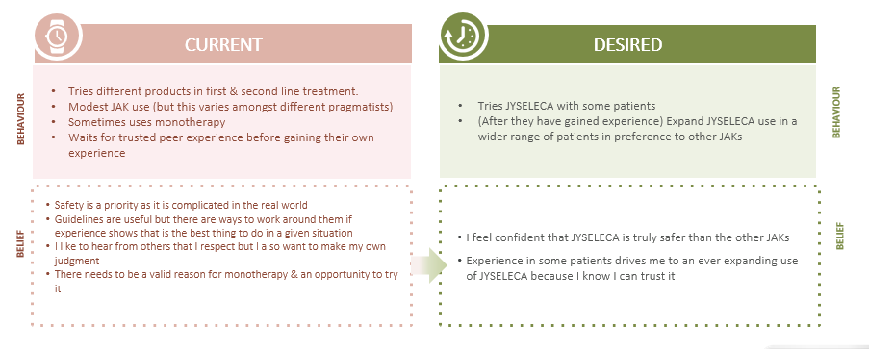
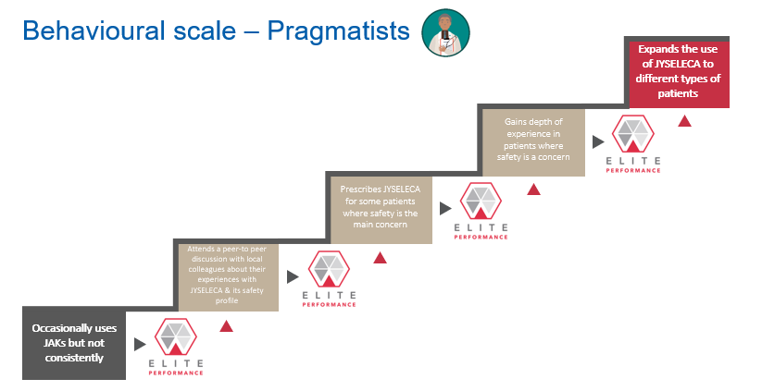




Preparation steps for success with JYSELECA
Prepare to hold your Winning Mindset | Recognise different customer types & drivers | Deep exploration of individual customer beliefs | Define assertive behavioural change objective

Slide 33


Winning Mindset narrative
To achieve our goals, our field and cross functional teams will need to hold a consistent Winning Mindset
A deep belief and confidence on what we do and the value we bring
Gives us the framework where our desire is to
thrive for excellence
A conscious decision to consistently overcome potential own blocks that prevent us from being at our best
Clear behavioural change objective focused on changing behaviour
Deep limitation & implication questioning & desire to understand
Closing the conversation with the agreement to act

Slide 34
Belief Maps
With a Winning Mindset firmly in place, Performance planning is the first step our field teams take for every customer interaction. Its emphasis is on defining the objective – what we want our customers to do differently; a change of behaviour. Therefore, each call needs to be guided by a behavioural change objective.
To understand our customers’ behaviour we first need to understand the beliefs that sustain that behaviour. Belief maps are a useful tool that help us map our customers’ beliefs as well as the changes required to achieve the behavioural change objective.
CURRENT
DESIRED
What the customer does now
What we would like them to do
BEHAVIOUR
BEHAVIOUR
What the customer believes that motivates how they behave
What the customer would have to believe to act differently
BELIEF
BELIEF

Slide 35
Customer Segmentation
In depth research into the different customer types enables us to better tailor our communication & approach
Mavericks
Pragmatists
Compassionates
Conformists
Early adopters who perceive differences in JAK1
Not tied to the rules but follow the science
Prioritise efficacy
Seek patient feedback to be seen as hero
“I am confident I can get the best outcome possible for each patient”
Rule breakers (within reason) due to strong trust in own experience
Work around the rules when needed
Prioritise safety
Rely on their own experience
“In my experience sometimes you need to bend the rules”
Patient-centric, want balanced treatment within the guidelines
Use guidelines as safety net
Most reward from improving patients’ lives
Looks to peers for reference
“I can do the best for my patients by following the data & guidelines”
Conservative, risk averse, and late adopters
Safety focused
Use guidelines as a safety net
Use own experience to efficiently save a challenge
“Sticking to what I know is the most effective way to manage my caseload”
Affiliate action:
Check & validate the segments at a local level
Adjust the characteristics or add local environmental info if required

Slide 36




Snapshot of segments through a behavioural lens
Gives direction on where to focus your resources over time to ensure successful launch and beyond
OPPORTUNITY TO NUDGE BEHAVIOUR EARLY AND LEVERAGE AS INFLUENCERS
LONG TERM APPROACH NEEDED FOR BEHAVIOUR CHANGE
MAVERICKS (20%)
Least habitual – most proactive towards change They anchor to what’s best for their patient, in particular finding the best efficacy for each individual patient Look to the authority of scientific evidence
PRAGMATISTS (26%)
Less habitual - adaptive and responsive to change but will have some default behaviours e.g. towards what they perceive to be the safest option Less influenced by others; lean heavily on their own experience
COMPASSIONATES (30%)
Still developing own habits but default behaviour is to stick to guidelines Care about what others think so want to conform to social norms, thus direct and indirect influence of others is important (Peers, KOLs Reps/TAEs; rules, guidelines)
CONFORMISTS (24%)
Have engrained habitual behaviours and reluctant to make the effort to change They anchor to what’s familiar & what they know Look to traditional & established sources of authority
Notes:
We provided an initial snap shot of the segments through a BE Lens
Lack of motivation and/or ability can be barriers that we address by developing behavioural triggers or nudges which may differ slightly for each segment
We have used the model and overlaid segment insights from activation plans and profiles to understand what the motivations, ability and start to identify triggers for each segment
An approach to take to your teams

Slide 37
Belief Map - Mavericks
CURRENT
DESIRED
Uses a very broad spectrum of products including JAKs
Uses very recently launched products
Able to talk extensively about new and pipeline treatments
Willing to act ahead of guidelines
Uses JYSELECA as preferred JAK
Acts as an advocate for JYSELECA and shares their experience and expertise
BEHAVIOUR
BEHAVIOUR
JYSELECA offers the efficacy that patients need
Selective inhibition of JAK 1 is a significant innovation that will have practical implications for patients in the long term
In my hands, JYSELECA can provide great outcomes for my patients
There is a significant need for new treatments
Innovation & product development is necessary
There is an unanswered question about the difference between the JAKs
RA is a complex challenging condition so it is our responsibility to find an individual solution for each patient
I want to experience all the different products so I can make informed choices
I will make the decisions about which products to use and when – I don’t need guidelines to tell me
Guidelines are for guidance only and for doctors who are not experienced
Efficacy is key, safety is manageable
BELIEF
BELIEF
Work with your teams to build the belief maps according to local needs

Slide 38


Behavioural scale – Mavericks Leverage as early adopters & encourage advocacy
Advocates JYSELECA as JAK of choice
Shares positive experiences with colleagues
Prescribes JYSELECA as their ‘go to’ JAK
Reflects on early JYSELECA experience & positive efficacy outcomes compared with other JAKs
Uses a wide variety of treatments 1st line, including JAKs

Slide 39
BARRIERS
&GOALS
Behavioural Research Outcomes: MAVERICKS
What are the key barriers for this segment (motivational and ability) | MOTIVATION Fewer barriers as they are willing to try and change We may be able to get the change in the short term but we will need to plan for the longer term to avoid losing them to a new thing ABILITY Habit: they don’t form habits very easily. Time: more time pressure through the day: reading, researching (less available for us??). Social: more time pressure to get to the outcome. Mental: constant change = less mental bandwidth. Cost: rules
What triggers might overcome these barriers | Motivation Support/facilitate the change – make them feel at the forefront to pioneer the change (prescribe JYSELECA) Prescribing/thinking process very straightforward (Amazon 1 click) JYSELECA visibility/presence around them at the point of decision Involve them in projects / give them visibility with peers – to turn him/her into KOL or ambassador Provide insights on benefits for patients – engage in PSP (Stepwise)
Priority messages for this segment | Focus on efficacy data (broad) and fair level of AEs - The balance of the treatment for their patients. Efficacy and safety. Help them to see a specific patient pathway/solution
Top 5 things to consider for this group | 1. Change is a friend and an enemy (watch out)
 | 2. Facilitation – how can we make it easy (the 1-click Amazon version of prescribing)
 | 3. JYSELECA visibility/presence around them at the point of decision (salience)
 | 4. The balance of the treatment for their patients. Efficacy and safety.
 | 5. Words to amplify: INNOVATIVE Word to avoid: TRADITION
Words to amplify or avoid | AMPLIFY New Innovative Change Patient-centred Pioneer | AVOID Traditional Standard Status quo Mainstream

Slide 40
Belief Map - Pragmatists
CURRENT
DESIRED
Tries different products in first & second line treatment
Modest JAK use (but this varies amongst different pragmatists)
Sometimes uses monotherapy
Waits for trusted peer experience before gaining their own experience
Tries JYSELECA with some patients
(After they have gained experience) Expand JYSELECA use in a wider range of patients in preference to other JAKs
BEHAVIOUR
BEHAVIOUR
Safety is a priority as it is complicated in the real world
Guidelines are useful but there are ways to work around them if experience shows that is the best thing to do in a given situation
I like to hear from others that I respect but I also want to make my own judgement
There needs to be a valid reason for monotherapy & an opportunity to try it
I feel confident that JYSELECA is truly safer than the other JAKs
Experience in some patients drives me to an ever-expanding use of JYSELECA because I know I can trust it
BELIEF
BELIEF
Work with your teams to build the belief maps according to local needs

Slide 41
Behavioural scale – Pragmatists Gradually develop depth of experience & JYSELECA will become JAK inhibitor of choice
Expands the use of JYSELECA to different types of patients so ultimately JYSELECA becomes JAK of choice
Gains depth of experience in patients where safety is a concern
Prescribes JYSELECA for some patients where safety is the main concern
Attends a peer-to peer discussion with local colleagues about their experiences with JYSELECA & its safety profile
Occasionally uses JAKs but not consistently

Slide 42
BARRIERS
&GOALS
Behavioural Research Outcomes: PRAGMATISTS
What are the key barriers for this segment (motivational and ability) | Need an additional motivator to start (as focused on their own experience) Need to get the right patient 1st – otherwise will get off to the wrong start Preconceived notion that JAKIs aren’t fully safe Not fully bought into JAK selectivity
What triggers might overcome these barriers | COVID-19 raising the opportunity to use new treatments Simplicity of JYSELECA RW evidence Anchoring to safety over other JAKIs Comparison to ADA – nudge to superiority Repeated sharing of patient profiles Positive experiences from early use – feeds into other scripts – use other examples in past to understand trigger to start prescribing Use anchoring based on current JAK safety to highlight the clear safety benefits Keeping them abreast of new JYSELECA trials
Priority messages for this segment | Safety profile overall and vs. JAKIs Forest Plot ACR50/70 Patient profile page JAK1 selectivity
Top 5 things to consider for this group | 1. Ensure they fully understand that GG recognise that own experience is key
 | 2. Acknowledge how important safety is for them and highlight they are using the safest JAKI
 | 3. Initial patient feedback is key – snowball to other patients
 | 4. Use of patient portraits to hit on breadth of use
 | 5. Social norms to avoid
Words to amplify or avoid for this segment | AMPLIFY Positive patient experience / feedback Confidence Safest JAK available Trust in own judgement – give credibility to this | AVOID This is what others do KOL references Cost Highlighting doing the wrong thing

Slide 43
Belief Map - Compassionates
CURRENT
DESIRED
Use a variety of products & MoAs within guidelines
Closely monitors patient function & DAS score as a stimulus for switch
Starts to use JYSELECA as 1st line JAK inhibitor after TNF failure
BEHAVIOUR
BEHAVIOUR
The priorities of my patient are a key factor in my treatment choices so long as the best option for them is within the guidelines
I like to understand what my peers and authority figures are using and what their experience is
I would push the boundaries for my patients but I would want to be confident that I wasn’t taking risks
I want to get the right balance of safety and efficacy in order for my patients to have a good response and quality of life
There is room for improvement with anti-TNFs
Orals are a better option for some of my patients than injectables
JYSELECA provides my patients with a good balance of safety and efficacy that I feel confident in – more so than with other JAKs
I am happy with the experience that my patients have with JYSELECA – I hear positive feedback & they are able to do what is important to them
I am not compromising on efficacy by giving JYSELECA instead of another anti-TNF
BELIEF
BELIEF
Work with your teams to build the belief maps according to local needs

Slide 44
Behavioural scale – Compassionates Start gradually, driven by patient need & confidence of guideline inclusion – slowly becoming first line JAKi
Starts to use JYSELECA as first line JAK inhibitor
Monitors feedback & safety signals in JYSELECA patients
Prescribes JYSELECA for some patients where safety & simplicity are important
Attends a discussion with local expert about their experiences with JYSELECA & its safety profile
Uses a variety of products based on patient need & guideline recommendations

Slide 45

BARRIERS
&GOALS
Behavioural Research Outcomes: COMPASSIONATES
What are the key barriers for this segment (motivational and ability) | Environment must be supportive (peers, guidelines, etc.) Risk averse Payer guidelines are not supportive of JAKs
What triggers might overcome these barriers | Seeing others in authority use JAKs (Nat'l KOLs) Patient requests, patient benefit information Use of clinical data - made as simple as possible Help patients deal with loss aversion, understand benefits
Priority messages for this segment | Set up support of local guidelines Safety pages Focus on patient need Establish MOA (Tx framework)
Top 5 things to consider for this group | 1. Use supportive environment to make it easy for them to use (guidelines, peers, etc.)
 | 2. Appeal to patient centricity (Simplicity, efficacy, safety, any benefit to patient)
 | 3. Use patient profiles to get them thinking about the benefit to specific patient (simplifies choice)
 | 4. Will need to see peer endorsement, and compliance with guidelines
 | 5. Avoid cognitive overload – don’t give too much information
Words to amplify or avoid for this segment | AMPLIFY Used by KOLs You’re not the first/only one Patient quality of life Patient as a person (not a joint, or DAS score) | AVOID “Leading edge” Pressure/overbearing: “You should/have to…”

Slide 46
Belief Map - Conformists
CURRENT
DESIRED
Uses TNF first line – MTX IR populations.
Only uses a JAK if three or more biologics have failed or if it is a challenging patient who is very against injectables, or very demanding
Regularly use JYSELECA following 1st TNF failure
BEHAVIOUR
BEHAVIOUR
I want to use trusted products that I have experience with first
Guidelines offer confidence and back up – that is why I use biosimilar TNF first.
I feel comfortable with the safety profile of the TNFs
There is no need for more treatment options
JAKs are complicated to use and require too much work
Newer options should be used when you’ve run out of options.
Treatment choice shouldn’t be a struggle; it is counterproductive to explain every step you take.
JAKs don’t offer any additional benefits– in fact they might be riskier
EULAR & ACR guidelines support 1st line use of JAKs so earlier use is endorsed and there is a growing body of evidence to support this evolution
JYSELECA is simple to use – 200mg once per day
There is no need to think about dosing impact on side effects – one less thing to worry about
There are low discontinuation rates – patients seem to be comfortable on it and are unlikely to come back with problems
It’s easy to explain to patients so it keeps things simple & has a good safety profile
I feel as confident with JYSELECA as I do with anti-TNF
BELIEF
BELIEF
Work with your teams to build the belief maps according to local needs

Slide 47
Behavioural scale – Conformists Slow to gain first experience, will cautiously move towards JYSELECA use
Prescribes JYSELECA to identified patient & monitors
Identifies a suitable patient & invites them for review & discussion of options
Reviews list of potential patients with first TNF failure to discuss JYSELECA benefits
Attends a peer-to peer discussion with local colleagues about how JYSELECA is being incorporated into the guidelines
Uses JAKs very late line – TNFs first

Slide 48

BARRIERS
&GOALS
Behavioural Research Outcomes: CONFORMISTS
What are the key barriers for this segment (motivational and ability) | ‘New’ product not included in guideline for early line Current satisfaction with set algorithm/treatments
What triggers might overcome these barriers | Product Licence/approvals Reference relevant local guidance – easily applicable to them / their practice Scientific evidence: robust depth of data (build traditional authority) Ease of integrating into algorithm / simple Rx info
Priority messages for this segment | Finch1 – vs ada – ‘gold standard’ (as a substitute for guidelines) Finch 2 data – BIO-IR patient data (confident in later use) Low risk; assured safety: esp. CV (remove worry about ‘risk’ – cognitive burden) Straightforward option – where no current option e.g. Needle phobic/contraindicated
Top 5 things to consider for this group | 1. Mention Licence / indication
 | 2. Remind EULAR recommendation for 1st line use
 | 3. Highlight reimbursement status
 | 4. Bring in any supporting local guidelines
 | 5. Simple Rx info/support
Words to amplify or avoid for this segment | AMPLIFY Compliant with/ in accordance with Within the label Ease, manageable, straightforward Evolution Established | AVOID Typical marketing lingo / sales speak Latest, newest, complex, revolution

Slide 49
ELITE Performance core campaign

Slide 50




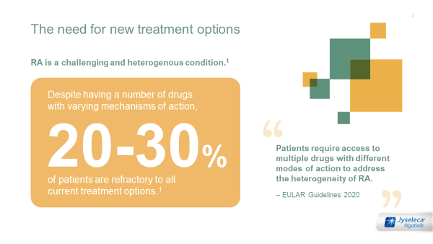
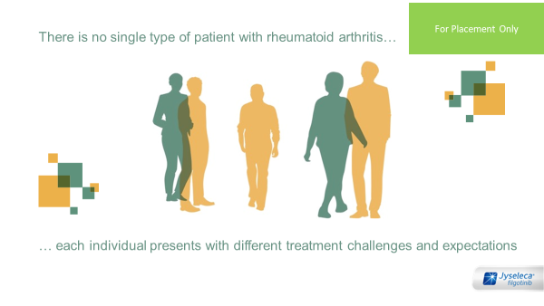
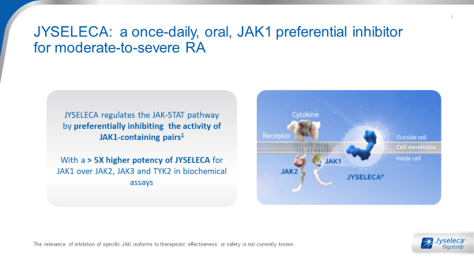
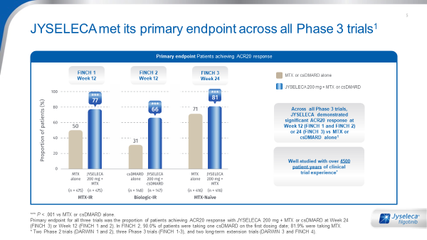
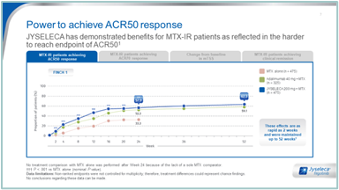
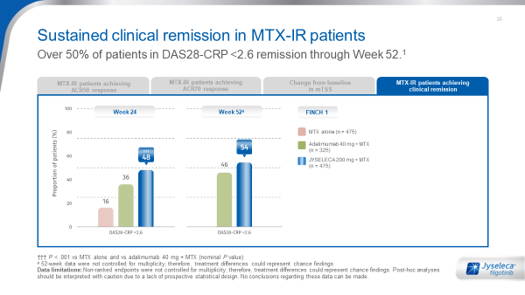
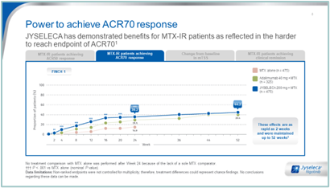
Campaign – core story
Key slides for a short call
JYSELECA introduction
UNMET NEED
Patient intro*
JYSELECA MOA
PHASE 3 program
Efficacy
ACR 50/70
REMISSION
Introduce JYSELECA & share the call objectives
Gain agreement that there is still a need for new treatment options
Agree that each RA patient is different and has individual needs and challenges
Introduce JYSELECA MoA
Explain the framework to the studies & reassure that JYSELECA met its primary endpoint across all Phase 3 trials
Show that JYSELECA provides fast and lasting efficacy across a variety of measures (ACR70 is key) with demonstrable disease modification not just symptom relief
With JYSELECA, 50% of patients achieve remission (DAS28-CRP) through 52 weeks
JYSELECA, a new treatment for moderate to severe active rheumatoid arthritis in adult patients.
Despite the advances in RA treatment, and a broad selection of available advanced therapies, new treatment options are still needed as almost a third of patients still don’t respond to current treatment options
Agree on treatment goals: fast, lasting and efficacious
JYSELECA is a JAK1 preferential inhibitor for moderate to severe RA

Slide 51

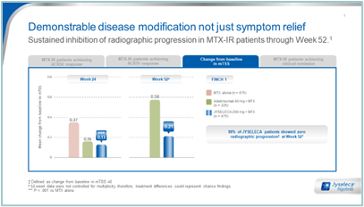
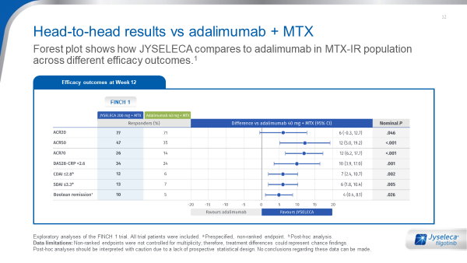
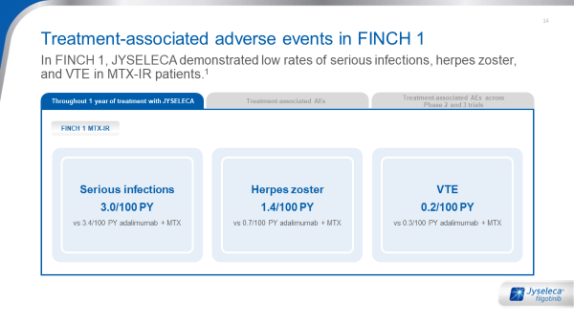
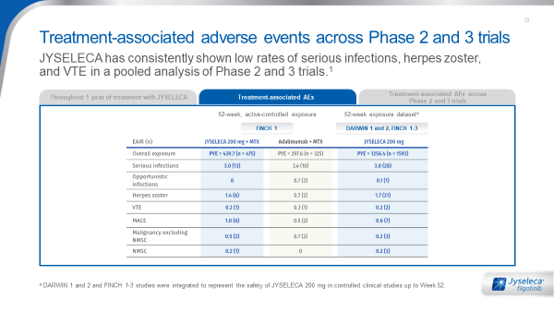
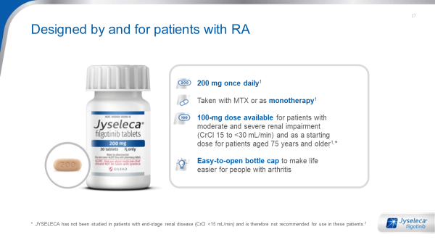
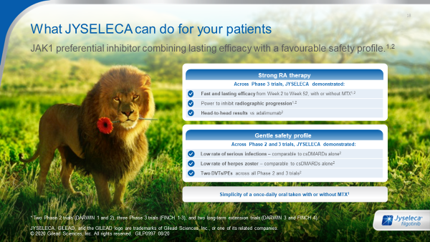
Campaign – core story
Key slides for a short call
RADIOGRAPHIC PROGRESSION
Comparison with soC
Safety - CLASS
Safety - SOC
Convenience
PATIENT-FOCUSED ACTION
To show why JYSELECA is efficacious with demonstrable disease modification not just symptom relief.
“88% of JYSELECA patients showed zero radiographic progression at Week 52”
Provide confidence that JYSELECA performs favourably compared to the SOC, adalimumab
Show that in FINCH 1, JYSELECA demonstrated low rates of serious infections, herpes zoster, and VTEs.
Reinforce that there are no statistical differences between JYSELECA and adalimumab expected adverse events and that there are low rates of expected adverse events also across phase 2 & phase 3 trials
Share the added benefit that JYSELECA features an easy-to-open bottle cap to make life easier for people with arthritis & convenient once-daily dosing.
Bring back the conversation to the patient profile & treatment goals selected for the call.
Close the call with an agreement to act
Proposed to communicate the DDI verbally after presenting JYSELECA convenience and dosing

Slide 52
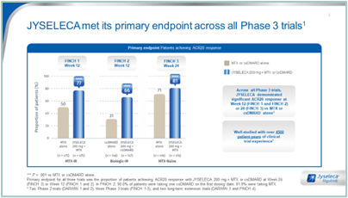
Story flow – short call
MOA
Efficacy
Comparable to soC
Safety - CLASS
Convenience
Introduce differentiating JYSELECA MoA
Show that JYSELECA provides fast and lasting efficacy across a variety of measures (ACR70 is key) with demonstrable disease modification, not just symptom relief
Provide confidence that JYSELECA performs favourably compared to the SOC, adalimumab
Show that in FINCH 1, JYSELECA demonstrated low rates of serious infections, herpes zoster, and VTEs.
Share the added benefit that JYSELECA features an easy-to-open bottle cap to make life easier for people with arthritis & convenient once-daily dosing.
.
JYSELECA is a JAK1 preferential inhibitor for moderate to severe RA

Slide 53
Core story - page by page Including suggested ELITE Performance questions & segment key highlights from market research

Slide 54
Introduction
Implementation:
If this is an early stage of your relationship with the customer, this is a key point to better
understand the customer, determine which segment they may align with and uncover their experiences relating to the patient focus: moderate to severe active rheumatoid arthritis in adults. Highlight that the picture represents a combination of efficacy & safety and understand their perspective on this balance.
It is critical to set out your objectives for the engagement here (e.g. depending on customer type, stage of launch and your relationship, objectives may vary from gaining their feedback on the information around JYSELECA to starting to get experience & identifying an appropriate patient). In addition, ensure you understand what they are seeking to achieve from seeing you today.
Suggested ELITE Performance questions
Before we discuss JYSELECA in more detail, I’d love to know about how familiar you are with the JAKi class and JYSELECA in particular (If knowledgeable about JYSELECA then explore deeper on what they understand and their perceptions, how they have heard about it)
How do JAKi currently fit in to your treatment approaches for moderate to severe RA patients?
Link to the next page
The next page focuses on establishing the need for JYSELECA. Depending on their answers to the questions suggested above, start to move to a discussion on “the reason we have developed JYSELECA is…”
E
Purpose of this page:
Introduce JYSELECA: a new treatment for moderate to severe active rheumatoid arthritis in adult patients.
Naturally powerful - leader of the pack
Can be strong & gentle – secure
Balance of two things, flower = gift / caring
54
Notes:
Repeat as needed

Slide 55
Unmet need
Implementation:
Set up the unmet need upfront but don’t focus on the treatment refractory patients of the
Individual physician as it could be misinterpreted as an accusation. Focus on the EULAR reference to avoid misunderstanding and the chance of the HCP taking it personally.
Get acknowledgement first before moving on but don’t spend too much time unless doctor shows interest. Research shows that this step doesn’t need to be overstressed – it is well accepted.
If the HCP does not consider there is room for new options in RA treatment, ask them for 5 minutes to present a high-level overview on JYSELECA and the outcomes achieved in clinical trials.
Suggested ELITE Performance questions
Do you agree that there is room for new options in RA treatment?
In case the HCP says there is no improvement needed: How do you define treatment success? (be ready to describe the definition of ‘refractory to treatment options’ in EULAR guidelines)
If there is the perception that there is no unmet need: How do you gain experience of the new treatments that become available? Will you be willing to try a new JAK 1?
Link to the next page
Do not proceed until the HCP agrees that there is room for new treatment options in some patient types or at least a willingness to hear more.
Let me introduce you to the features of JYSELECA – I would really like to hear your perspective
E
Purpose of this page:
Gain agreement that there is still a need for new treatment options
Most likely groups to be willing to try new treatment options & want to develop personal experience. They know & recognise the statistics – move quite quickly to avoid over emphasising & frustrating the customer
Focus on EULAR guidance and what a treatment failure means for the patient – this patient focus sets a good context for the discussion
Focus on EULAR guidance and what a treatment failure means for the HCP/practice. Reminds them that new treatments are valuable
Adaptation:
Each country to build their slide with their preferred visuals and claims, and local guidelines or references
55
Notes:
Repeat as needed

Slide 56
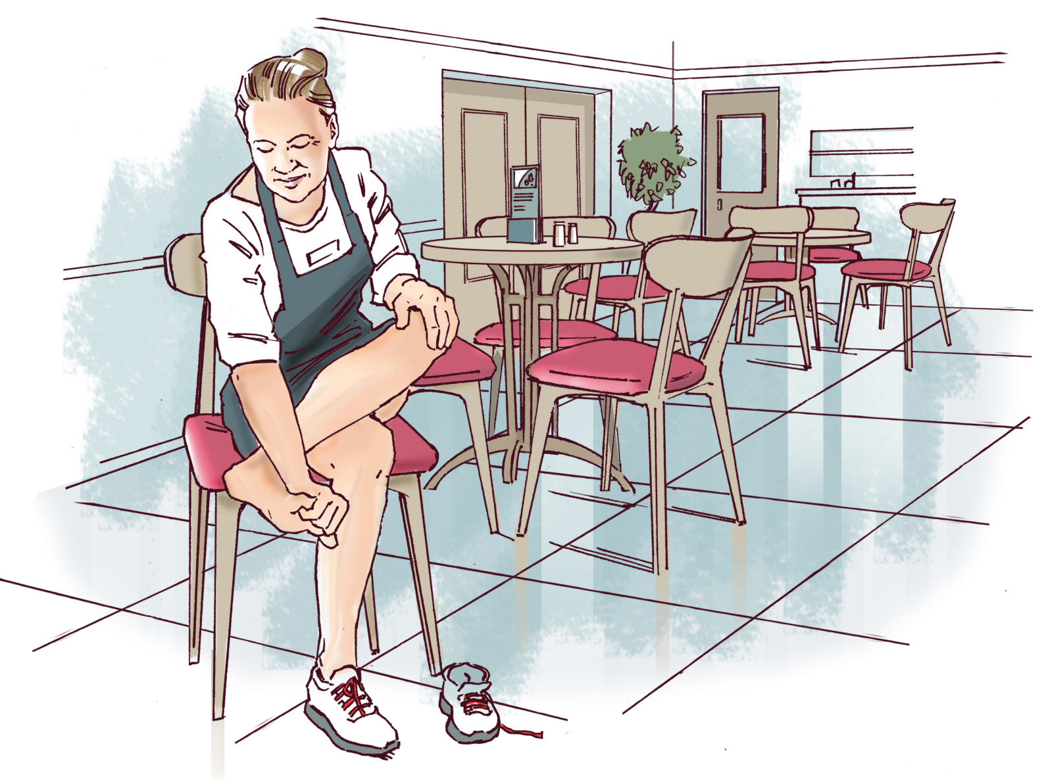


Patient type
Implementation:
This is a great opportunity to understand the different types of patients that they treat and what
they are aiming to achieve. When exploring the treatment expectations, start to set up the need
to balance between efficacy (fast & lasting) as well as safety. Discuss further in order to gain insight into what drives them and motivates them to prescribe a JAKi (or what stops them from considering a JAKi). This is an important step in the call whilst also balancing time available to discuss the data.
Suggested ELITE Performance questions:
Get agreement: What types of patient do you see most frequently and what are their challenges? What impact does that have on you / your clinic / them?
Uncover their prescribing driver: How do your treatment goals vary depending on the patient you are treating? What drives the goal that you set for treatment success for individual patients? Does the balance of efficacy and safety that you are looking for vary depending on the patient needs?
Guide the HCP to focus on a patient they may already be thinking for JAKI – what are the types of situations or patient needs that lead you to consider a JAKi?
Link to the next page
Introduce the clinical trial comparator. Get consensus that the SoC is adalimumab
The comparator that was used in the pivotal studies for JYSELECA was adalimumab – would you describe that as standard of care in your clinic? Why is that?
L&I
Slide to be developed locally
Purpose of this page:
Agree that each RA patient is different and has individual needs and challenges
.
Focus on each case being different – almost like a puzzle that is waiting to be solved. They will have a standard of care but will be flexible depending on the situation. Mavericks use JAKi in early line and as monotherapy
Focus on the patient perspective of treatment challenges & expectations
Most likely to perceive patients as homogeneous – some different types but won’t focus on individual needs so much
Adaptation:
This slide of the campaign has to be built locally based on the patient portraits and images from the next slide
56
Notes:
Repeat as needed

Slide 57
Patient portraits – short*
Implementation:
Review the market research results locally to understand which portraits resonated best & adapt as needed. We recommend incorporating only 1 or 2 portraits within the story flow. More guidance will be provided on completion of the market research testing on the portraits. These portraits provide an opportunity to stimulate the customer to identify a patient who may be appropriate for JYSELECA aligned to where JYSELECA provides the most benefit & our strategy. This also provides an opportunity to probe further on a number of levels:
Suggested ELITE Performance questions:
Is this a patient you see commonly?
What treatment would this type of patient typically be on? Why is that? What stimulates you to review their treatment in this situation – clinical markers or patient feedback?
What are your concerns for the future with this patient? What is most important to them?
Link to the next page
As I share more with you about the profile of JYSELECA, I would love to hear your opinion on how JYSELECA may benefit patients like XXX and you may choose to use JYSELECA in your treatment decisions with this type of patient.
In pain/rapidly progressing
Need for monotherapy or convenience
Essential to maintain physical function
FINAL PATIENT PORTRAITS UNDER REVIEW TO GET GLOBAL ALIGNEMENT
Female in 40s
No plans to have (more) children
Increasing pain severely impacts work and home life
Expressed interest in oral treatment as compatible with active lifestyle
Concerned about day-to-day tolerability
Seeking fast, lasting efficacy in the simplicity of an oral
Middle-aged female
Inadequate pain relief and SEs from current treatment
Would prefer oral treatment to better fit with busy work schedule
Wants to avoid multiple drug regimens
Finds adherence challenging due to side effects
Seeking convenience, efficacy & safety without MTX
Male over 50
Poor response to current treatment
Reduced joint function would severely impact livelihood
Hypertensive but no other comorbidities
Would like alternative to injections
Seeking to prevent progression with an easy to manage treatment
*Detailed patient profiles in the appendix
57

Slide 58
Mode of action – Introduction
Implementation:
This page provides the reason to believe that JYSELECA is different to other JAKs. Different customer segments will have different levels of interest in the precise MoA details. Ensure that regardless of segment the message is clear that there is a high degree of selectivity & that JAK 1 was chosen on purpose as a new treatment MoA in RA (language refinement to come following finalisation of research). JYSELECA’s JAK-1 selectivity is key to leverage as a point of difference.
Suggested ELITE Performance questions
What is your takeaway from this MoA? What implications could it have for patients?
What role does MoA play in your treatment decision making process?
Would you like to receive the MoA video? (reason to get consent, follow-up)
Link to the next page
Let’s explore which patients could benefit from JYSELECA treatment
E
Purpose of this page:
Introduce JYSELECA MoA & level of selectivity for JAK1-dependent signalling over JAK2-dependent signalling
The video might resonate better with Mavericks & Pragmatists than other segments. Mavericks especially have strong belief in selectivity leading to clinically significant differences. If possible, call out positive differences over Rinvoq regarding selectivity
Introduce the MOA to ensure clarity on selectivity as a differentiator but do not go into much detail at this stage – unlikely to be their priority
Adaptation:
Adapt only based on local guidelines and references – minimal changes necessary or appropriate
58
Notes:
Repeat as needed

Slide 59
Efficacy - Phase 3 program
Implementation:
Provide an overview of the JYSELECA Phase 3 trials – especially in the initial calls and if country legislation requires this. The PYE for JYSELECA (Patient Years Experience) is shown on this page so it is important that the TS can confidently explain what this means. Highlight that ACR20 is statistically significant across all target populations (try not to spend too much time here as ACR20 is not the most important efficacy outcome)
Suggested ELITE Performance questions:
None recommended – focus more on responding to any queries that the customer may have and moving on to the harder to reach efficacy endpoints
Link to the next page:
I would like to hear your perspective on the JYSELECA data for the more difficult to achieve outcomes, such as ACR 50 & 70…
L&I,T
Purpose of this page:
Explain the framework to the studies & reassure that JYSELECA met its primary endpoint across all Phase 3 trials
Minimal focus for these segments, move quickly to ACR50 and ACR70
Demonstrating strong efficacy across multiple patient groups: can enable them to ‘solve problems’ across a wide group of patients
Use as a foundation to highlight the weight of evidence through clinical trials conducted: A clear need to see that JYSELECA is built on a strong foundation (given the lack of personal experience)
Adaptation:
Adapt only based on local guidelines and references – minimal changes necessary or appropriate
Adaptation:
Adapt only based on local guidelines and references – minimal changes necessary or appropriate
59
Notes:
Repeat as needed

Slide 60
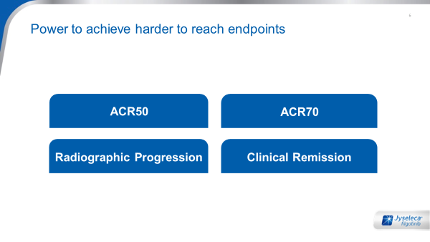
Efficacy measures overview
Implementation:
This page is your efficacy ‘home page’ enabling you to move to the efficacy measure that is of
most importance to the physician. ACR 70 was most differentiating in market research so, where possible, focus on this page & the FINCH 1 data. There is no need to go through all of the 3 efficacy pages here as engagement levels can drop & the safety element of the story is a key differentiator and deserves time and focus.
Suggested ELITE Performance questions:
Which efficacy outcome is most important to you when choosing a new treatment for your moderate to severe RA patients?
What makes you focus on that efficacy measure?
What is your expectation of JAKi efficacy across these efficacy endpoints?
Link to the next page
The next page shows the remission outcomes that can be achieved with JYSELECA. Relate back to earlier questions about the goal of treatment – if they mentioned remission then link to that comment and move to the remission data. If remission hasn’t been discussed so far, segue by asking how they view these clinical measures in the context of remission
L&I,T
Purpose of this page:
Show that JYSELECA provides fast and lasting efficacy across a variety of measures with demonstrable disease modification not just symptom relief
Top efficacy focus: FINCH 3 (esp. ACR50/70); Clinical remission;
Benefits of monotherapy in inhibition of radiographic progression
More likely to be interested in discussing ACR50/70 in detail
Focus on efficacy through the lens of patient outcomes & patient benefits. Ensure time to reassure on safety as this is key for this segment
Will need personal experience to be convinced – remind them of early experiences with ADA and the confidence they now have, underlining the trial comparator
Adaptation:
Adapt only based on local guidelines and references – minimal changes necessary or appropriate
60
Notes:
Repeat as needed

Slide 61
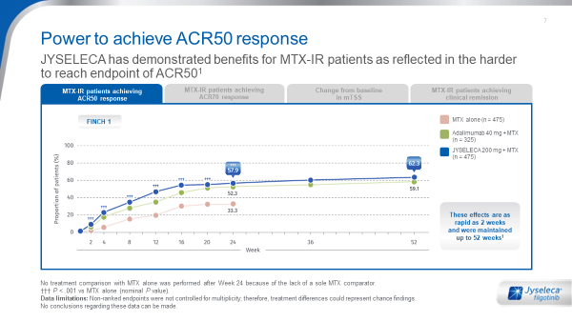
Efficacy – ACR50
Implementation:
Allow the HCP a moment to reflect on the data – be prepared to answer questions on trial design, try to move quickly to ACR70 as this is the page that was most interesting to HCPs in research out of the efficacy section. To avoid any confusion / suspicions about transparency ensure clear sign-posting of the comparison in combination with MTX and the significant difference relates to MTX, mono.
Suggested ELITE Performance questions:
What is your perspective on these data? What is your experience with other treatments when aiming for ACR50?
If they have already tried JYSELECA – What is your experience with JYSELECA?
What are you looking for in terms of efficacy from a treatment for MTX-IR patients?
What difference can fast and lasting efficacy have for them?
Link to the next page:
Show ACR70 data: Let me show you now ACR70
L&I,T
Purpose of this page:
Fast and lasting efficacy (ACR responses) from Week 2 to Week 52, with or without MTX
An important page for all segments. Key words: Strong, fast, sustained. Focus on what they can achieve with JYSELECA. This will be an important page for all segments but Mavericks will be most interested in ACR70
An important page for all segments. Focus on efficacy through the lens of patient outcomes & patient benefits. Ensure time to reassure on safety as this is key for this segment
An important page for all segments. Will need personal experience to be convinced – remind them of early experiences with ADA and the confidence they now have, underlining the trial comparator
Adaptation:
Adapt only based on local guidelines and references – minimal changes necessary or appropriate
61
Notes:
Repeat as needed

Slide 62
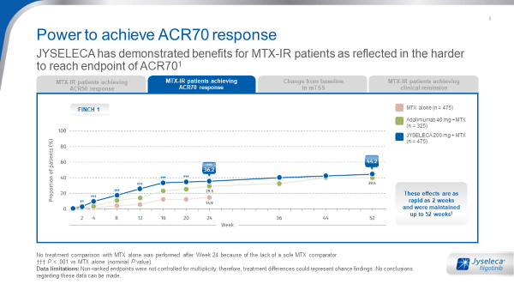
Efficacy - ACR 70
Implementation:
This page was a key differentiator in market research and of great interest. Allow the HCP some time here to consider these data
Suggested ELITE Performance questions:
Do you agree that ACR70 is often a harder to reach endpoint in trials?
What is your experience with other treatments when aiming to achieve ACR70?
What difference does fast & lasting ACR70 make from a clinical perspective (compared with ACR20 /50)? When you use a treatment that enables the patient to achieve ACR70, what difference does that make to them (compared with ACR20 / 50)? What additional activities can they do as a result?
Link to the next page:
Depending on the time you have available with the customer, you may want to move directly to the remission data. However, where possible, link from this page to reassure the customer that as well as clinical outcomes achieved, JYSELECA is able to achieve disease modification, not just symptom relief.
L&I,T
Purpose of this page:
Fast and lasting efficacy (ACR responses) from Week 2 to Week 52, with or without MTX
Important page especially for Mavericks
Key words to use: Strong, fast, sustained
Focus on what they can achieve with JYSELECA not just on what JYSELECA offers. Ensure both segments see ACR50 & ACR70 data
They will be convinced by ACR50 so ACR70 provides further credibility but not main interest. Focus on efficacy through the lens of patient outcomes & patient benefits. Ensure time to reassure on safety as this is key for this segment
Will need personal experience to be convinced – remind them of early experiences with ADA and the confidence they now have, underlining the trial comparator. Least likely segment to be interested in ACR70
Adaptation:
Adapt only based on local guidelines and references – minimal changes necessary or appropriate
Notes:
Repeat as needed

Slide 63
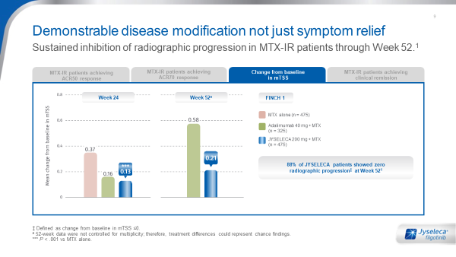
Efficacy – Radiographic Progression
Implementation:
88% is a notable figure compared with adalimumab & captures attention. Ask their perspective
on the data as opposed to highlighting the difference between adalimumab – ADA is standard of care and they are quite protective of it. Some customers may not be familiar with the mTSS graph and how that relates to 88% patient showing no radiographic progression at week 52.
Suggested ELITE Performance questions:
What level of radiographic progression do you expect in your MTX-IR patients?
How do you describe radiographic progression to your patients – is that something they would ask about when you introduce a new treatment to them?
Link to the next page:
Relate back to earlier questions about the goal of treatment – if they mentioned remission then refer back to that comment and move to the remission outcomes that can be achieved with JYSELECA. If remission hasn’t been discussed so far, segue by asking how they view these disease modification results in the context of remission. What expectations would you have for remission if you had been able to achieve these disease modification outcomes with a treatment?
L&I,T
Purpose of this page:
To show why JYSELECA is efficacious with demonstrable disease modification not just symptom relief.
“88% of JYSELECA patients showed zero radiographic progression at Week 52”
Interested in benefits of monotherapy in inhibition of radiographic progression. Likely to be aware that progression is low with most treatments but still important to make them aware of JYSELECA data
Perceive radiographic progression inhibition as strong rationale for earlier use to prevent structural damage - present after ACR70 data to maintain interest
Focus on efficacy through the lens of patient outcomes & patient benefits. Consider their concerns around progression to disability & patient longer term goals
Least likely segment to focus on this page. Will need personal experience to be convinced – remind them of early experiences with ADA and the confidence they now have, underlining the trial comparator
Adaptation:
Adapt only based on local guidelines and references – minimal changes necessary or appropriate
63
Notes:
Repeat as needed

Slide 64
Efficacy – Remission
Implementation:
Many physicians will be more familiar with DAS28-CRP but remission means different things to
different people so make sure you are clear what it means to your customer and how they measure it
Suggested ELITE Performance questions
How do you know when your patients have achieved remission, how do you measure it? (make sure they are confident that whatever measure they use, JYSELECA achieves it – 50% of patients sustained DAS28-CRP <2.6 remission through Week 52
What proportion of patients do you expect to achieve remission by the end of a year of treatment?
What does remission mean to you?
How do you describe remission to your patient – do you share their scores, what would you tell them?
How do they respond when you are able to tell them that they are in remission?
How does remission impact your patient’s life?
Link to the next page
We’ve looked at a variety of efficacy measures today – I’d like to share a summary so that you can see the full picture of efficacy with JYSELECA
L&I,T
Purpose of this page:
Show the data for clinical remission - Demonstrable clinical remission irrespective of how it is measured & 50% of patients sustained DAS28-CRP <2.6 remission through Week 52
More likely to talk about the different measures of remission – emphasise breadth of measurements
Remission is very important to them. Open to using JAKi in earlier lines if they see a clear benefit (remission) and low risks
More likely to be interested in talking about the patient benefits from remission
More likely to be interested in improvements in pain and physical functioning
Adaptation:
Adapt only based on local guidelines and references – minimal changes necessary or appropriate
64
Notes:
Repeat as needed

Slide 65
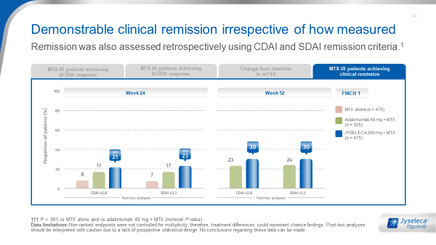
Back up slide – Clinical Remission
Implementation:
For those Drs who look beyond DAS28-CRP for clinical remission measurement, this page enables a deeper discussion on the extent of the clinical remission demonstrated by JYSELECA. Do not use this page for those Drs who predominantly use DAS28-CRP and are already convinced by the efficacy profile of JYSELECA
Suggested ELITE Performance questions:
What do the CDAI and the SDAI tell you beyond the DAS28-CRP scores?
Do you expect results to be consistent across the different remission measures (if no, why not, what does this mean to you?)
How have other JAKi compared with ADA in CDAI and SDAI?
Which of the clinical trial measures of remission do you find to be the most reliable marker of what you expect to see in clinical practice?
Link to the next page:
We’ve looked at a variety of efficacy measures today – I’d like to share a summary so that you can see the full picture of efficacy with JYSELECA
L&I,T
Purpose of this page:
Show the data for clinical remission using CDAI and SDAI - Demonstrable clinical remission irrespective of how it is measured & 50% of patients achieve remission (according to DAS28-CRP scores) through Week 52
Mavericks are most likely to be interested in these additional measures of remission – this will appeal to their nature & enable you to learn more about what they value. This is the only segment likely to be interested in Boolean data
Unlikely to see what this adds over the DAS28-CRP data – not an essential page for this group
Unlikely to see what this adds over the DAS28-CRP data – not an essential page for this group
Unlikely to see what this adds over the DAS28-CRP data – not an essential page for this group
Adaptation:
Adapt only based on local guidelines and references – minimal changes necessary or appropriate
Notes:
Repeat as needed

Slide 66
Efficacy – Compared to Standard of Care
Implementation:
Keep your language neutral and allow the HCP to draw their own conclusions – this is likely to
be one of the most impactful parts of the story, allow them to read it and take your cues from how they respond to these data. This is a key page so make sure you give some time to it in your call; it could be seen as a positive summary depending on how the previous efficacy pages have been discussed.
Suggested ELITE Performance questions:
What resonates with you from these data? If you compare this to other treatments in RA, how does this look to you – have you seen results like this before?
What do you consider to be the key takeaway?
Objection may be raised here around non-inferiority vs nominal superiority – guidance on this will be available in the objection handler – coming soon
Link to the next page
Relate back to the discussion at the beginning of the conversation and the balance between efficacy and safety, reflecting their language.
I would now like to introduce you to the safety profile of JYSELECA and hear your perspective on these data
L&I,T
Purpose of this page:
Show results vs ADA Forest plot shows how JYSELECA compares to ADA in MTX IR populations across different efficacy outcomes
Intellectually stimulated by this & will be keen to draw their own conclusions. Likely to understand the importance quickly so allow them to move on
Strong efficacy is important to them but this may feel repetitive so ensure you spend enough time convincing them of the safety of JYSELECA to overcome their reluctance with JAKi
If they are already convinced on ACR50 this may be a quick page enabling you to spend time to reassure on safety as this is key for this segment
They like inclusion of ACR20 here but may need range of data explained. Likely to be least familiar with Forest plot and very attached to ADA as standard of care
Adaptation:
Adapt only based on local guidelines and references – minimal changes necessary or appropriate
66
Notes:
Repeat as needed

Slide 67
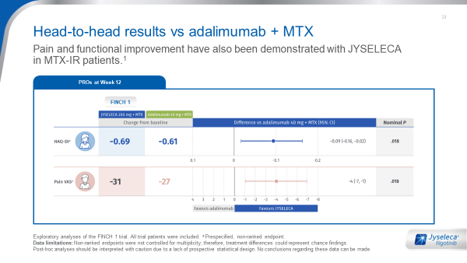
Back up slide - Head-to-head results, patient reported outcomes
Implementation:
For those physicians who are stimulated by patient feedback, these results will be important as they look beyond clinical parameters to patient reported outcomes and show JYSELECA to be comparable to their standard of care, ADA. As with the previous Forest plot, give time for the physician to reflect and make their own conclusion.
Suggested ELITE Performance questions:
What resonates with you from these data? If you compare this to other treatments in RA, how does this look to you – have you seen results like this before?
What do you consider to be the key takeaway?
[Refer back to the patient discussed at the beginning of the call] How important would this improvement in function / pain be to your patient? What kinds of activities of daily living do they avoid or miss out on because of pain and functional challenges?
Link to the next page:
Relate back to the discussion at the beginning of the conversation and the balance between efficacy and safety, reflecting their language.
I would now like to introduce you to the safety profile of JYSELECA and hear your perspective on these data
L&I,T
Purpose of this page:
Demonstrate how JYSELECA compares to ADA on patient reported measures including pain and functional improvement
Interested in PROs and patient feedback as well as wanting to appear in-tune with inclusion of data like these in clinical trials
A key page for this group – spend time to explore what this can mean for patients
Unlikely to see what this adds over the DAS28 data – not an essential page for this group
Unlikely to see what this adds over the DAS28 data – not an essential page for this group
Adaptation:
Adapt only based on local guidelines and references – minimal changes necessary or appropriate
67
Notes:
Repeat as needed

Slide 68
Safety – JAKi associated AE
Implementation:
This page is key for differentiation regarding safety in JAK associated AE and resonates well –
the rates are perceived to be low & similar to ADA.
Take this opportunity to reinforce the message once again around the balance between efficacy and safety.
Suggested ELITE Performance questions:
Given the efficacy you have seen, what expectations would you have of safety for a JAKi?
When you are considering using a JAKi, what AEs are you concerned about?
What impact does management of these AEs have on you and your patients and your use of JAKs? Does it impact your use of JAKi or is it something you have to manage?
Objection may be raised here relating to statins / fertility – guidance on this will be available in the objection handler – coming soon
Link to the next page:
Having established the safety profile relating to JAK-associated AEs, segue to safety outcomes that are not specifically linked to the class, in the next page
L&I,T
Purpose of this page:
JYSELECA is associated with low levels of JAK inhibitors associated AE
In FINCH 1, JYSELECA demonstrated low rates of serious infections, herpes zoster, and VTEs.
Less concerned as they see side effects as something they have to manage. However, they will see this page as differentiating since it is not what they expect.
Key focus: balanced safety & efficacy - no compromise. Their reluctance with JAKi is based on safety so they need to be convinced that JYSELECA is different. Appreciate the clear message on this page
Considers safety a key feature so this information is key to differentiate the JYSELECA. This will interest them to look at more detailed data on safety
Focus: Risk-averse group so highlight the well-established safety profile & be prepared to share more in-depth safety data
Adaptation:
Adapt only based on local guidelines and references – minimal changes necessary or appropriate
68
Notes:
Repeat as needed

Slide 69
Safety – Compared to Standard of Care
Implementation:
This enables a discussion on safety considerations that are often expected by the customer. HCPs are used to seeing placebo comparison so draw attention to the fact that this is vs adalimumab and it is comparable.
Suggested ELITE Performance questions:
Questions to explore any concerns for JYSELECA:
When you are using ADA, what if any, safety concerns do you have?
How do you tend to manage these?
How confident do you feel to manage a safety profile such as this?
Link to the next page:
The next page explores the discontinuation rates & the pooled safety data across Phase 2 and 3 trials. This is aligned to the data in FINCH 1
L&I,T
Purpose of this page:
There are low rates of expected adverse events vs ADA and no statistical differences between JYSELECA and ADA.
JYSELECA has consistently shown low rates of serious infections, herpes zoster, and VTE in a pooled analysis of Phase 2 and 3 trials
Need positive patient feedback & to be seen as ‘heroes’ so explore in the context of how patients describe their experience. Attracted to the detail provided
Appreciate the detail to feel reassured on safety. Highlight comparison to ADA as they will need a strong reason to be convinced by JYSELECA safety profile
Appreciate the detail to feel reassured on safety. ISS data may be too complex. Highlight the comparison to adalimumab to emphasize the gentleness and ‘peace of mind’ of JYSELECA
Highlight the comparison to ADA to emphasize that the adverse events are what they are used to seeing already – there aren’t unexpected surprises
Adaptation:
Adapt only based on local guidelines and references – minimal changes necessary or appropriate
69
Notes:
Repeat as needed

Slide 70
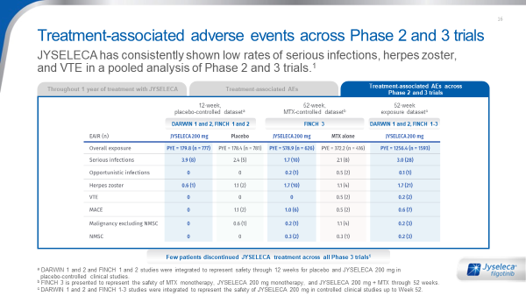
Safety – Compared to Standard of Care
Implementation:
This further emphasises the safety profile of JYSELECA and adds peace of mind. Only spend time on this page if the customer is very concerned about safety specifically and use it to reassure them that the profile is comparable to their standard of care – reflect the language that they use about ADA to help them feel confident about JYSELECA
Suggested ELITE Performance questions:
What do these safety data add to your perception of the safety profile of JYSELECA?
How important is it to you that a new product such as JYSELECA can offer safety & discontinuation rates comparable to ADA, your standard of care? What impact does that have on how you might start to integrate JYSELECA in your treatment decision making?
Link to the next page:
I’d like to move now to some of more practical elements of treatment as these are critical for RA patients (be more specific depending on patient type discussed)
L&I,T
Purpose of this page:
Few patients discontinued JYSELECA treatment across all Phase 3 trials
Discontinuation rates are low with JYSELECA and comparable with ADA and placebo
Need positive patient feedback & to be seen as ‘heroes’ so explore in the context of how patients describe their experience. Attracted to the detail provided
Appreciate the detail to feel reassured on safety. Highlight comparison to ADA as they will need a strong reason to be convinced by JYSELECA safety profile
Appreciate the detail to feel reassured on safety. ISS data may be too complex. Highlight the comparison to adalimumab to emphasize the gentleness and ‘peace of mind’ of JYSELECA
Highlight the comparison to ADA to emphasize that the adverse events are what they are used to seeing already – there aren’t unexpected surprises
Adaptation:
Adapt only based on local guidelines and references – minimal changes necessary or appropriate
70
Notes:
Repeat as needed

Slide 71

Convenience – for you and your patients
Implementation:
This is a key differentiating slide that resonated well in research so ensure you leave enough time to discuss the
points here. There are a number of features to explore and depending on the customer segment they may
resonate as benefits for themselves or their patients. Reflect the language you have already heard the customer use & encourage them to articulate the benefits and what they could mean. Key points to highlight are: The broad range of patients that JYSELECA is appropriate for; the bottle was specifically designed for and with patients.
Suggested ELITE Performance questions:
Explore if the HCP agrees that based on its features JYSELECA would bring simplicity
When you consider dosing and ease of use of a treatment, what features are you looking for? What benefit do these bring to you and your patients?
Which of these features of JYSELECA would be most important to you when prescribing JYSELECA?
What can the simplicity of JYSELECA bring to you and your patients? How does it impact the breadth of patients that JYSELECA is suitable for?
We have reviewed the efficacy & safety of JYSELECA and with this simplicity, what patient groups does this enable you to use JYSELECA compared with other JAKs?
Now that you’ve heard all about JYSELECA, how does this fit with the patient group we discussed at the beginning of the conversation? What benefits could it bring them?
Link to the next page:
The following page provides a summary of what was discussed today – before you move to it, ask the physician:
How would you describe JYSELECA to one of your colleagues – what are the key features that you think are important to share?
T
Purpose of this page:
Appropriate for use across a broad range of patients - easy to use for you and your patients
Avoid making treatment sound ‘easy’ as it may undermine the complexity of RA & the challenge that stimulates this group. They value the short precise facts
Key words to highlight wider range of patients – dosing and administration shows flexibility for different patients
Appreciate practical information & benefits for patients. Key words to highlight simplicity, once daily – bottle designed for & with patients
Key focus to highlight: flexibility & simplicity of use. A wider range of patients - meeting their need for compliance & minimal complications as prescriber
Adaptation:
Adapt only based on local guidelines and references – minimal changes necessary or appropriate
71
Notes:
Repeat as needed

Slide 72
Male fertility & DDI discussion
When to have the discussion:
Proactively in first call – when reaching convenience slide in campaign flow
Reactively thereafter
Guidance on how to discuss proactively:
Sperm Health
I would like to inform you about certain aspects that you need to take into consideration when prescribing JYSELECA
In animal studies changes were observed in semen parameters and fertility
However, in humans, the potential effect of JYSELECA on sperm production and male fertility and the reversibility of these potential effects is unknown
To address this, we have ongoing phase 2 studies, Manta and Manta-RAy investigating whether this signal is also seen in humans. The primary objective of the studies is to evaluate the effect of JYSELECA on testicular function
Until we can answer this question for you definitively, the potential risk of reduced fertility should be discussed with male patients before initiating treatment
If you require additional information, I can put you in contact with your Medical Scientist
DDI
In vitro trials could not exclude a potential interaction with OATP1B1 and B3 transporters. Therefore in the absence of in vivo data, co-administration with sensitive OATP1B1 or OATP1B3 substrates (e.g. valsartan, statins) is not recommended. An in vivo clinical trial is ongoing, and we expect results in the 1st half of 2021.
If you require additional information, I can put you in contact with your Medical Scientist

Slide 73

Patient-focused action
Implementation:
Summarise the next generation efficacy, differentiated safety profile & broad applicability for patient
groups (depending on what they focused on the most and were most interested in)
Suggested ELITE Performance questions
Ask a question to reinforce the area that they showed most interest in during the conversation
Based on the patient profile close relating to your objective – what needs to happen to ensure patients such as [patient type discussed] can receive JYSELECA? Which of your team need to be aware? How would you introduce JYSELECA to your patients?
If this customer has not yet provided consent: I can see you have a very busy schedule so it might be more convenient for you to receive some of the information I can share via email so that we can make the most of your time when we speak. Would you be willing to provide consent to receive emails from … [insert as compliant / company relevant]
E
Purpose of this page:
Bring back the conversation to the patient profiles & treatment goals
Revisit the behaviour change objective & close the call with an agreement to act
Framing the JYSELECA promise for each segment
Through the advancement of science, the latest JAK1 offers you the strong efficacy you expect with unsurpassed safety and impressive patient outcomes, placing you at the forefront of RA management
Through your own experience of using JYSELECA, you will quickly see that this is the safest JAKI available without compromising efficacy, thereby giving you full confidence to prescribe it in a wider group of patients
Other rheumatologists have started to see great benefits in using JYSELECA through the optimal balance of strong efficacy, unsurpassed safety and simplicity of a once daily tablet allowing patients to get back to living as normal a life as possible
We know your time is valuable and recognise that switching treatments can bring challenges to you and your patients. JYSELECA meets your needs by combining unsurpassed safety, strong efficacy in a simple once daily tablet that keeps patients on therapy and you in control
Adaptation:
Adapt only based on local guidelines and references – minimal changes necessary or appropriate
73
Notes:
Repeat as needed

Slide 74
Performance Analysis

Slide 75
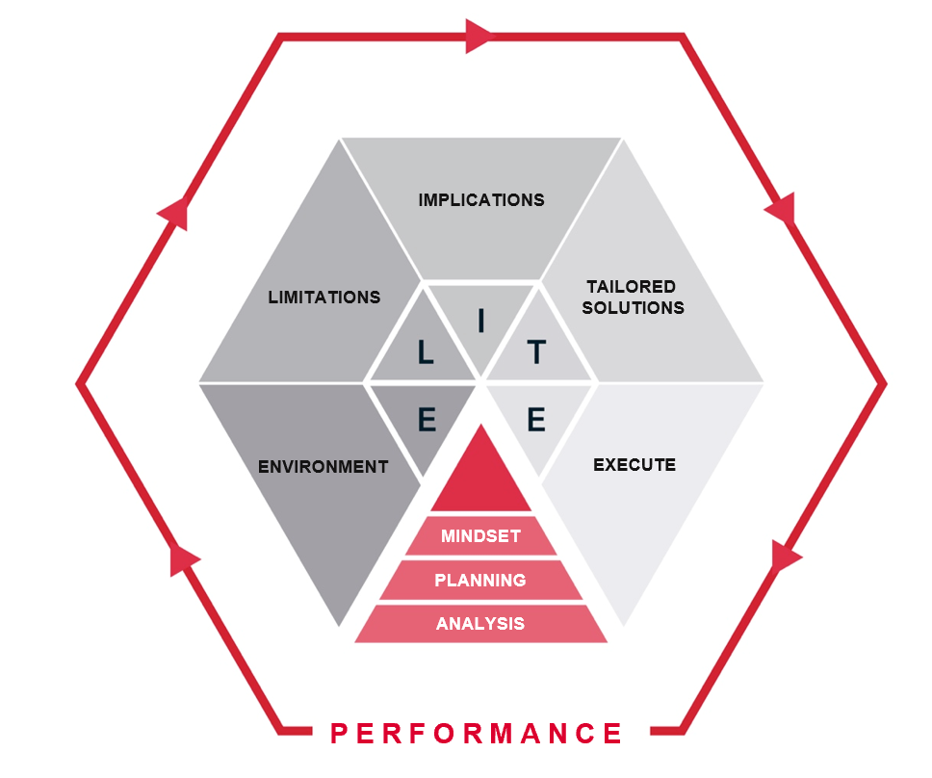
Performance analysis - Link back to your Performance Planning
After the call
Thorough Performance Analysis
Before the next call
Effective Performance Planning
75

Slide 76
Post-Call Analysis – Key Considerations
How has this call impacted on your long-term goal for this HCP or account?
What progress has now been made against the overall account goal or objective? And against the behavioural scale and beliefs?
What will your plan be for the next call with this HCP or in this account?
How will this call impact your approach to other HCPs in this account?
When and how will you follow up with this HCP?
76

Slide 77
Appendix – Detailed Patient Profiles
FINAL PATIENT PORTRAITS UNDER REVIEW TO GET GLOBAL ALIGNEMENT

